Slide 1
1.6.15 The exponential and trigonometric functions

Slide 2
Introduction
In this topic, we will
Deduce Euler’s formula
Make some observations on Euler’s formula
See a geometric interpretation
Determine the result when e is raised to a complex power
Verify this is likely correct
Make some observations
Deduce formulas for cos(z) and sin(z)

Slide 3
Review
Recall that
Thus,

Slide 4
Taylor series
In calculus, you either have seen or will see that the exponential and trigonometric functions can be written as Taylor series:

Slide 5
Taylor series
Substitute x with jθ :
Recall that, however, j² = –1, j³ = –j, j⁴ = 1, j⁵ = j, and so on
Break this into real and imaginary components:

Slide 6
Euler’s formula
Let’s look at:
Is it not fair to say ?
Thus, can we not write

Slide 7
Observation
Theorem:
Proof: As , it follows that
QED

Slide 8
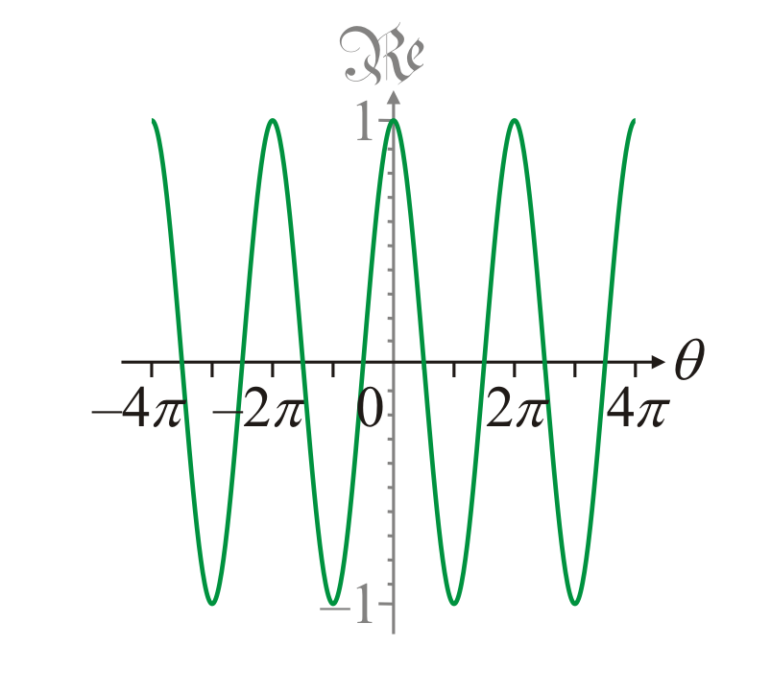
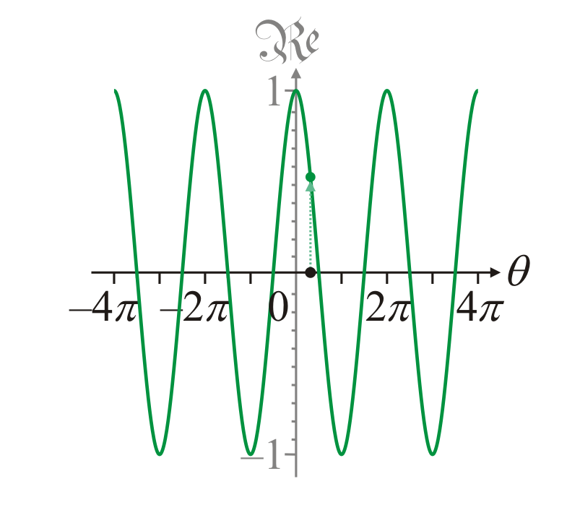
Geometric interpretation
Plotting cos(θ ) has you plot the value of cos(θ ) for all values on the abscissa
In this case, –4π ≤ θ ≤ 4π
You can read off the value, for example, cos(1)

Slide 9
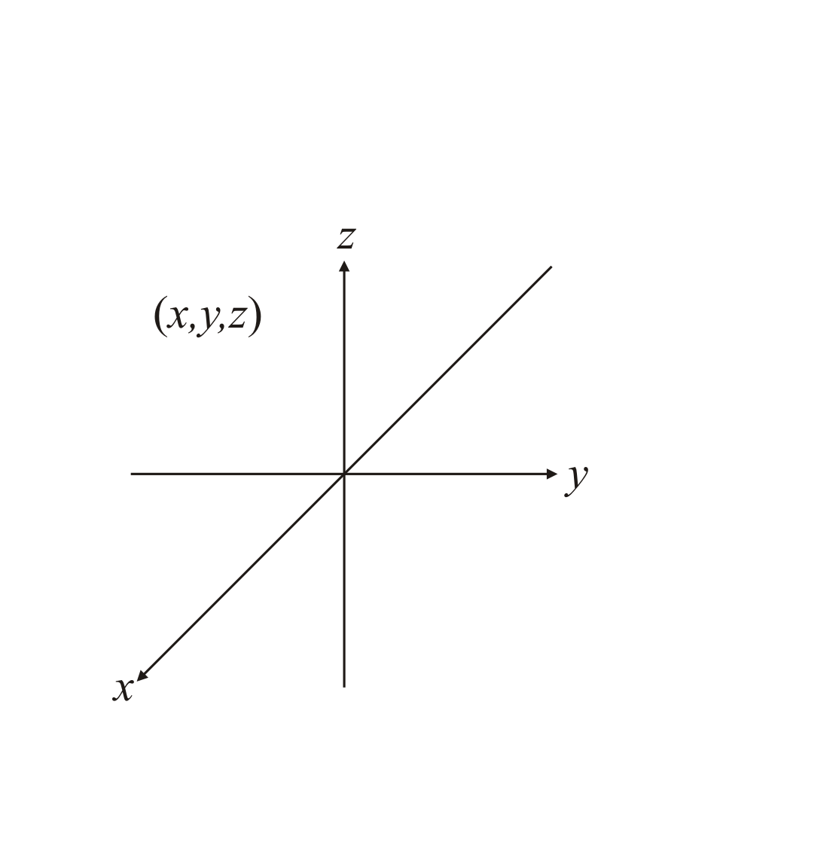
Geometric interpretation
Now, in plotting in three dimensions, we must project onto a plane
We use the right-hand rule to determine the axes

Slide 10
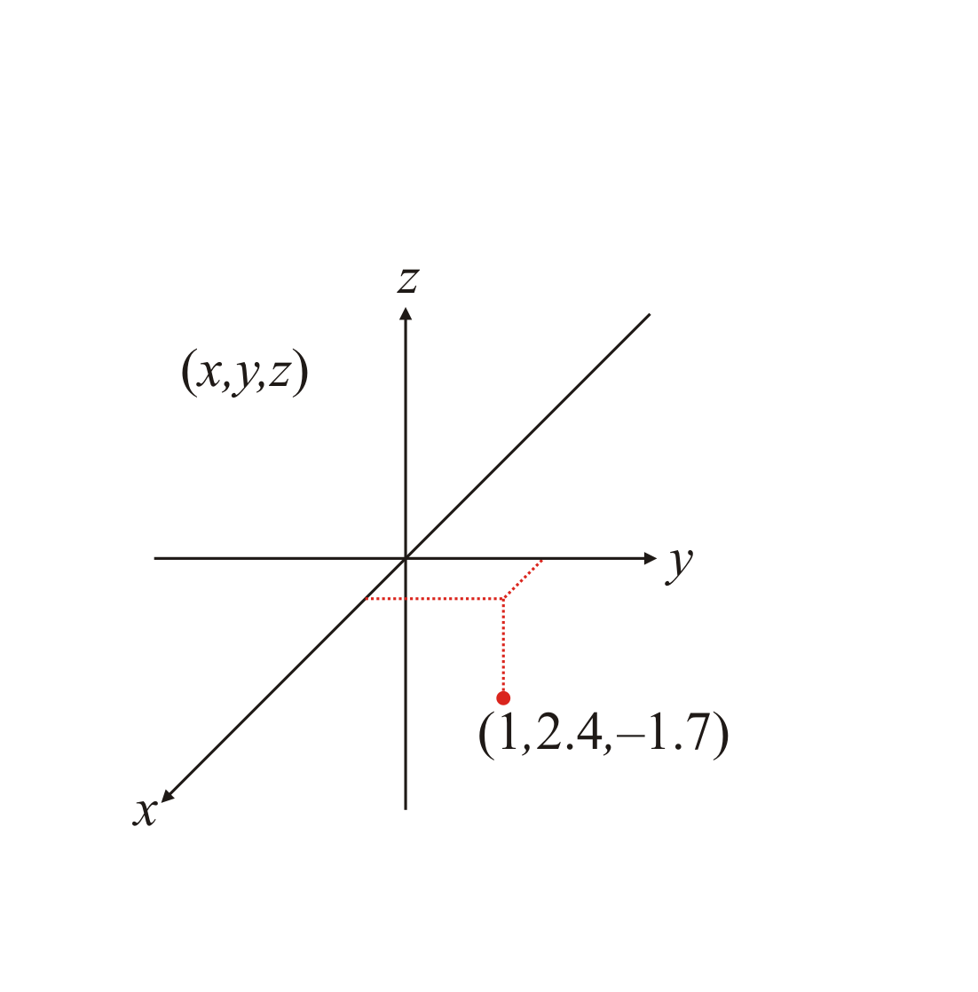
Geometric interpretation
To plot a point in three dimensions, you need a hint as to where that point is relative to the axes

Slide 11
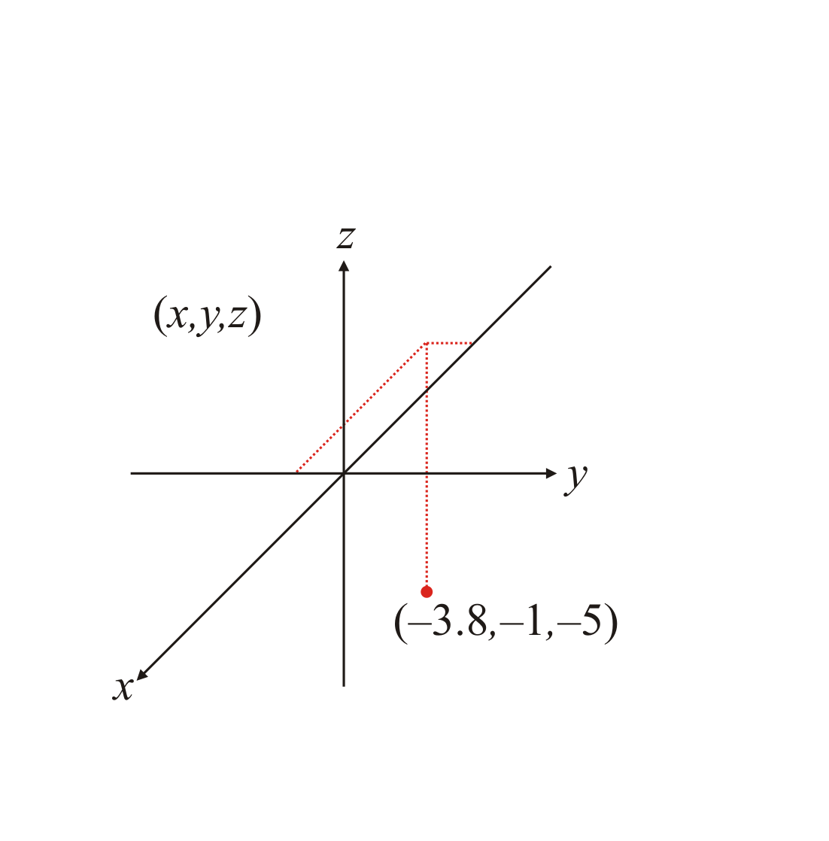
Geometric interpretation
This same point could represent many different values!
This is the result of us projecting 3-space onto a plane

Slide 12
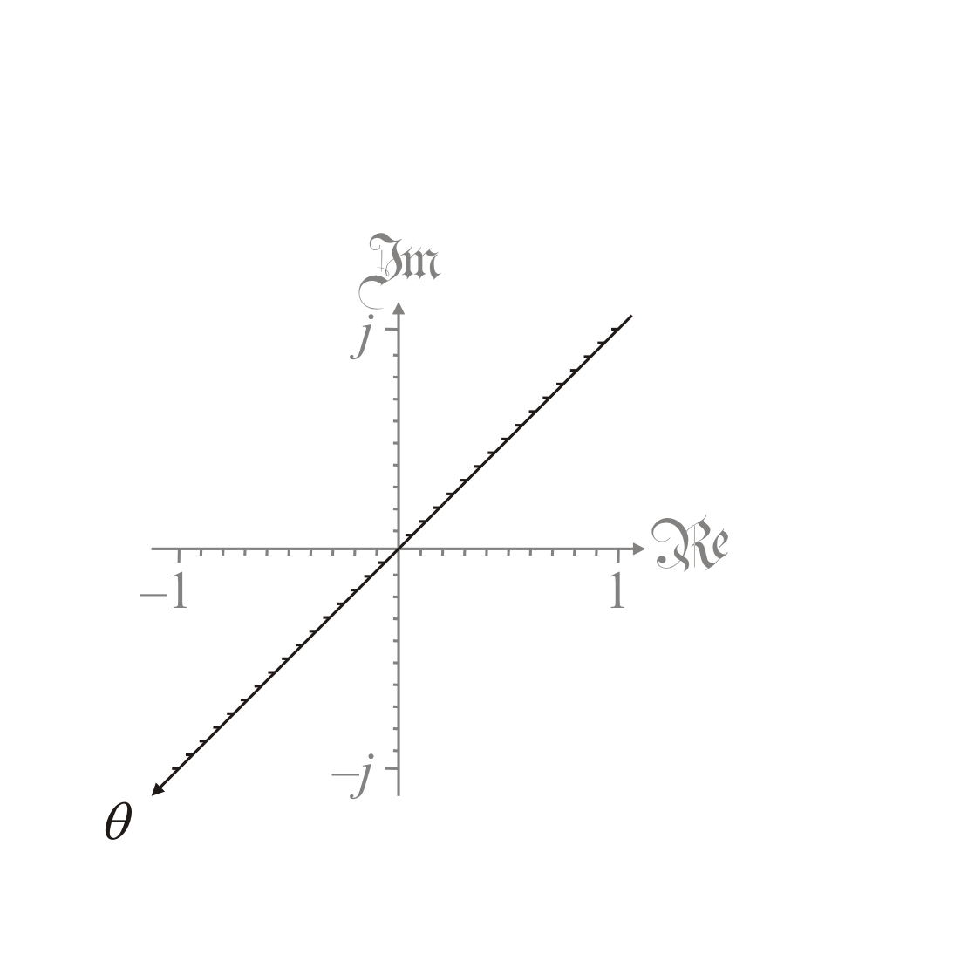
Geometric interpretation
When plotting a complex- valued function f of a real variable, the three axes will represent:
The independent variable θ
The real component of f (θ )
The imaginary component of f (θ )

Slide 13
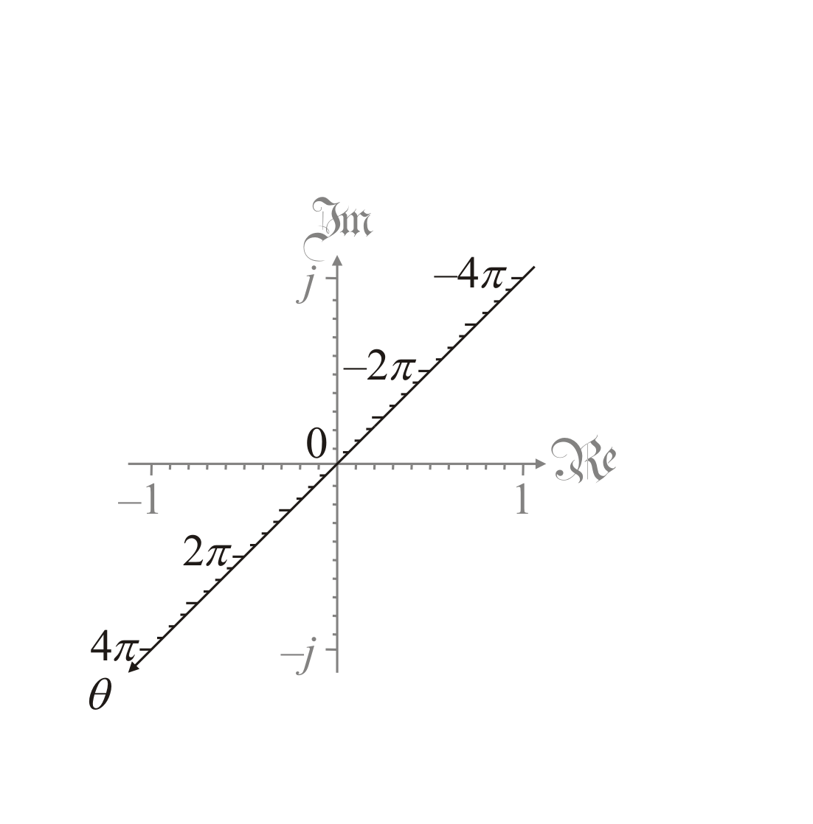
Geometric interpretation
Suppose we want to plot a function f on –4π ≤ θ ≤ 4π
We will try this first for cos(θ ) and then e^{θ j}

Slide 14
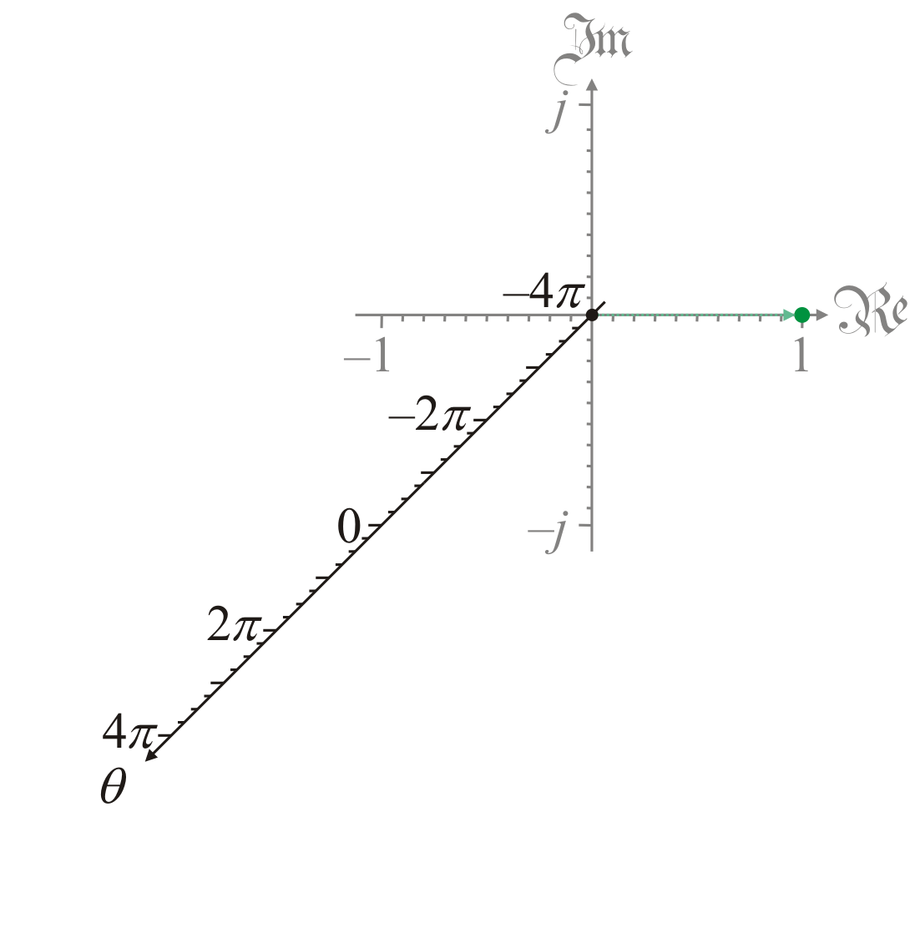
Geometric interpretation
First, we note that a function cos(–4π ) = 1
We emphasize this with an arrow

Slide 15
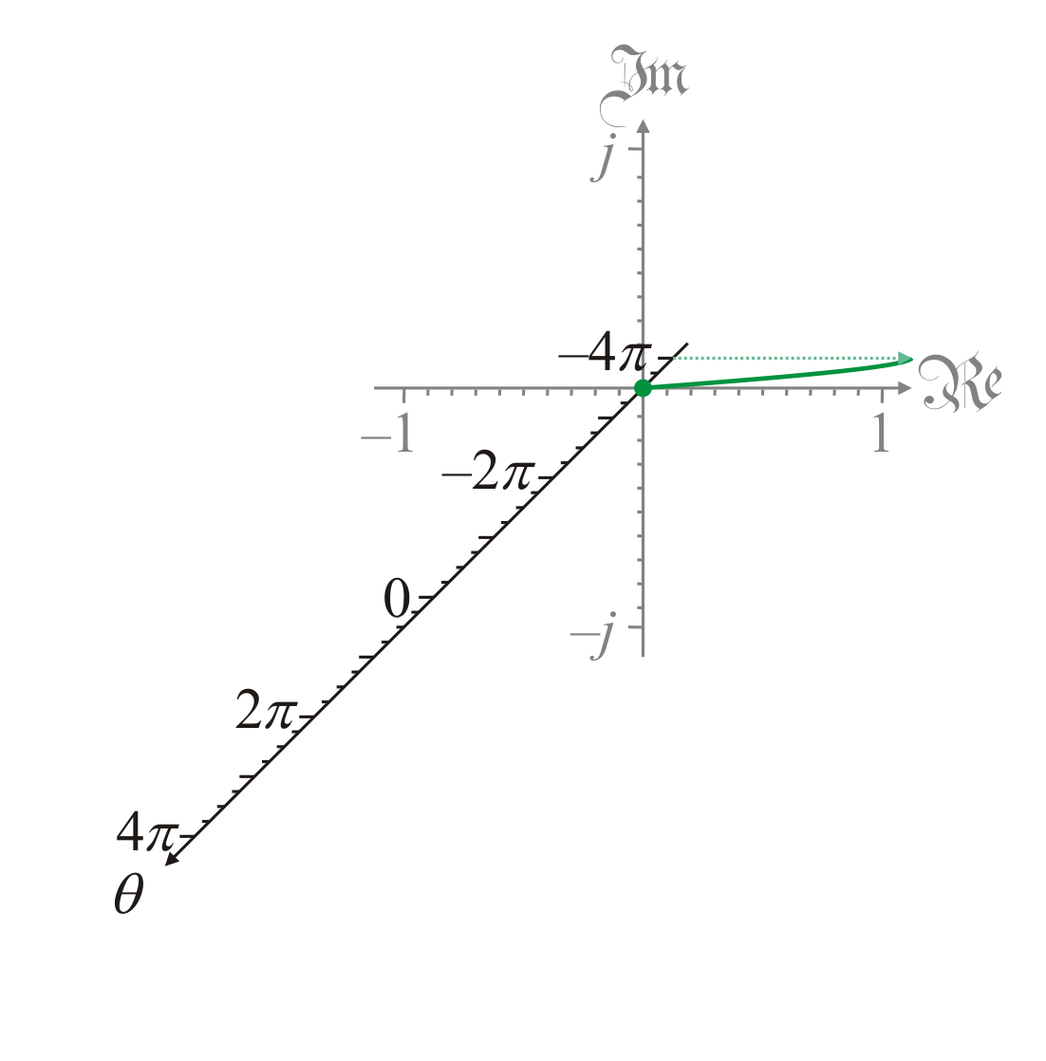
Geometric interpretation
Next, we note that cos(–3.5π ) = 0

Slide 16
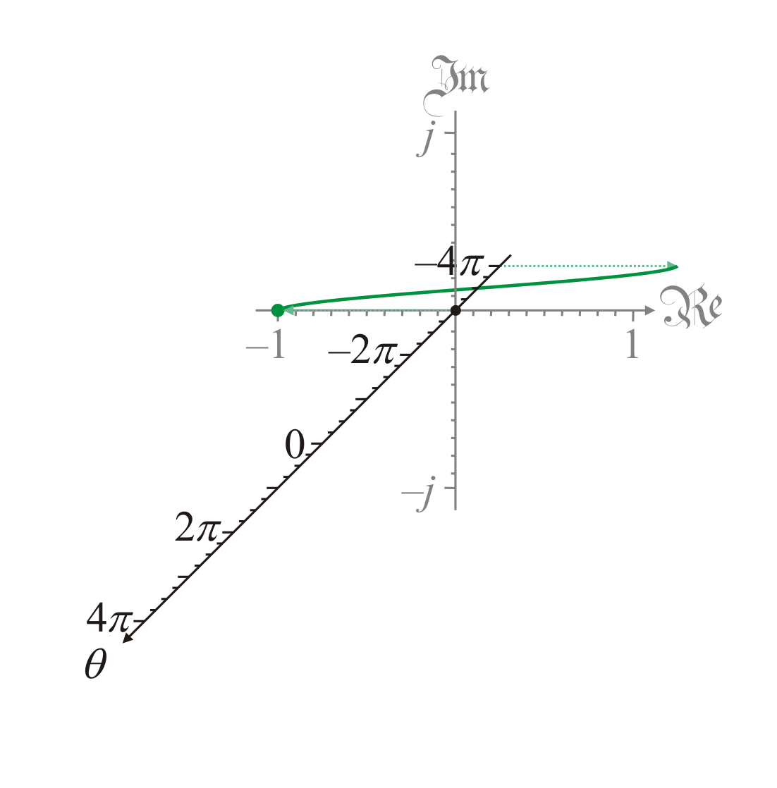
Geometric interpretation
Next, we note that cos(–3π ) = –1

Slide 17
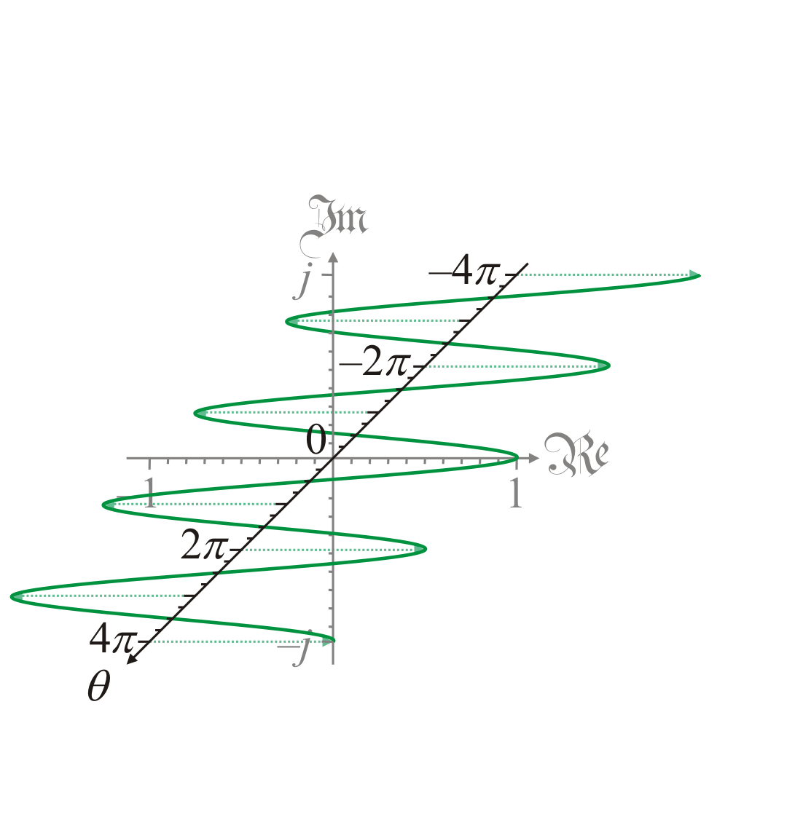
Geometric interpretation
Continuing this, we can plot the cosine function for all values in question
The imaginary part is always zero
All points lie in the xy-plane

Slide 18
Geometric interpretation
Next, lets plot e^{θ j}
This is a complex-valued function of a real variable
We note e^{–4πj} = 1

Slide 19
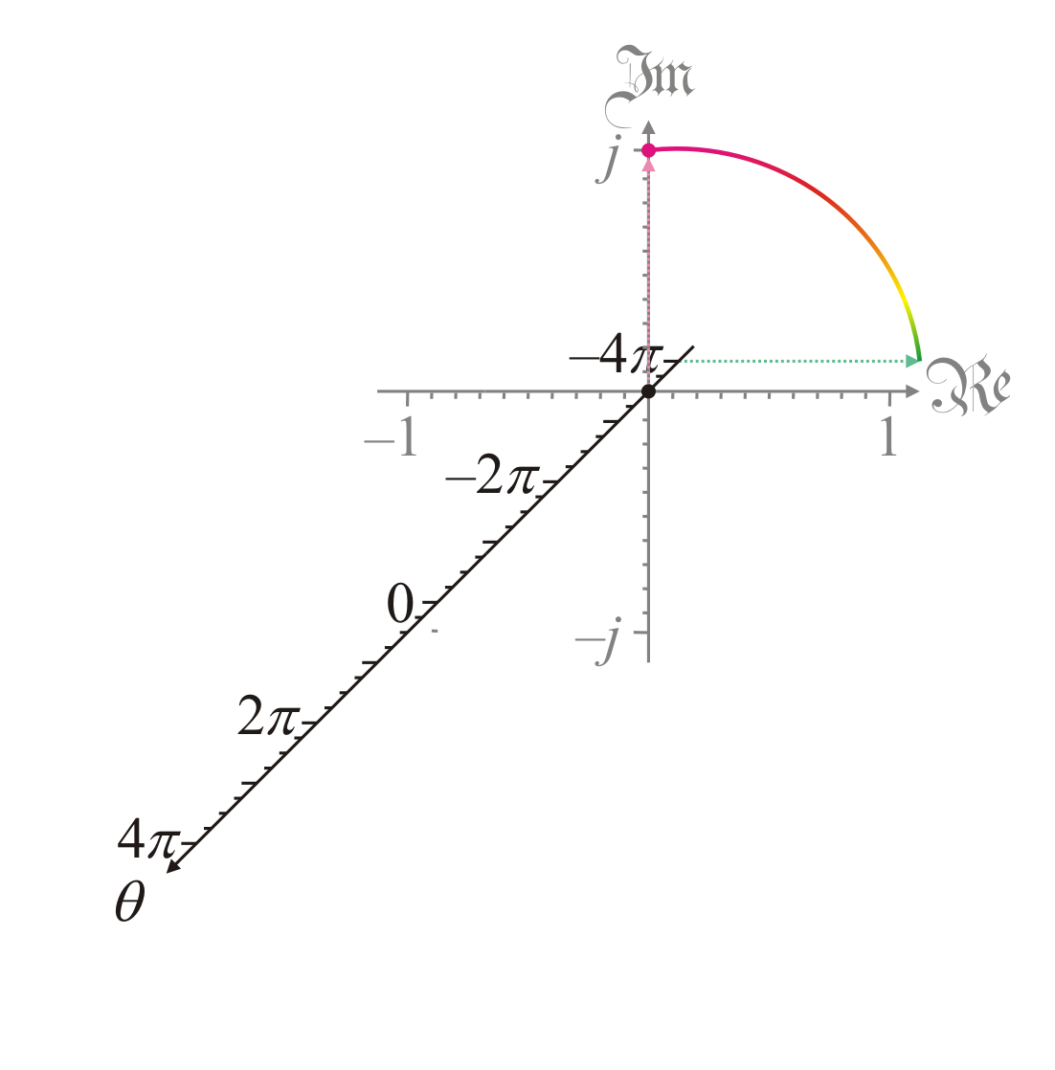
Geometric interpretation
Next, e^{–3.5πj} = j
We use color to highlight the value of the imaginary component:
Green is close to zero
Magenta is the most positive
Purple is the most negative

Slide 20
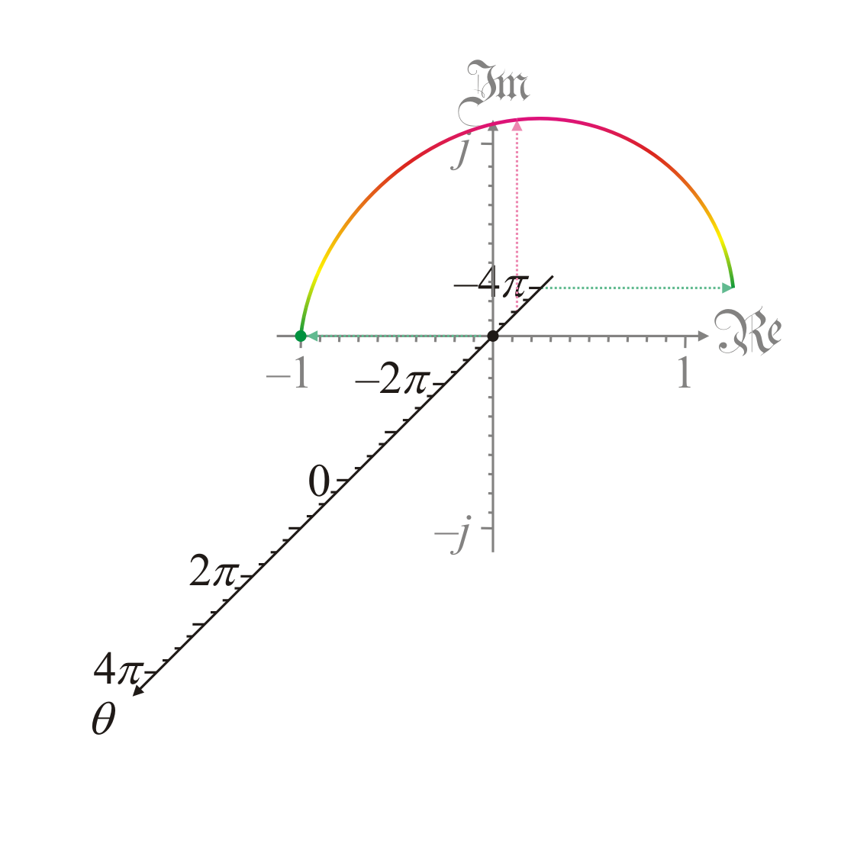
Geometric interpretation
Next, e^{–3πj} = –1

Slide 21
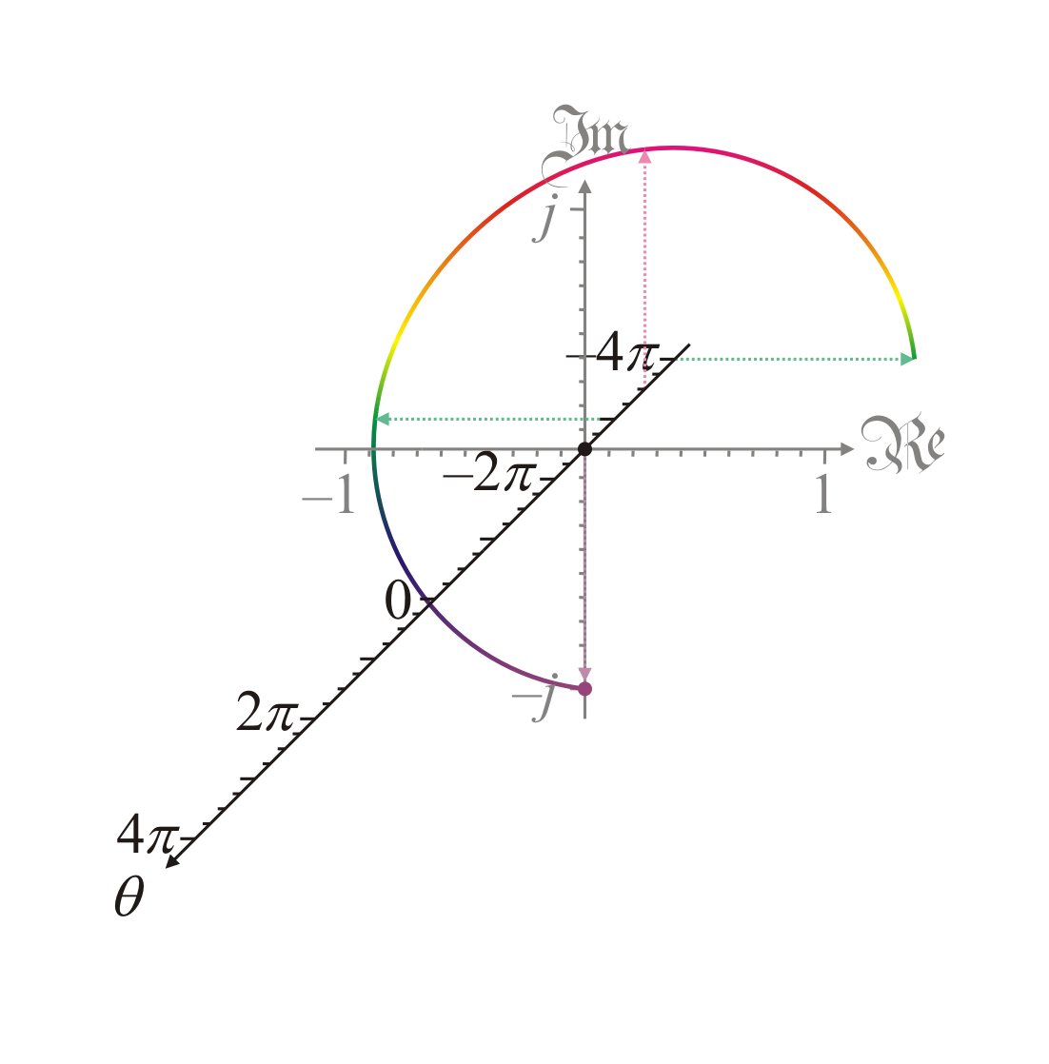
Geometric interpretation
Next, e^{–2.5πj} = –j

Slide 22
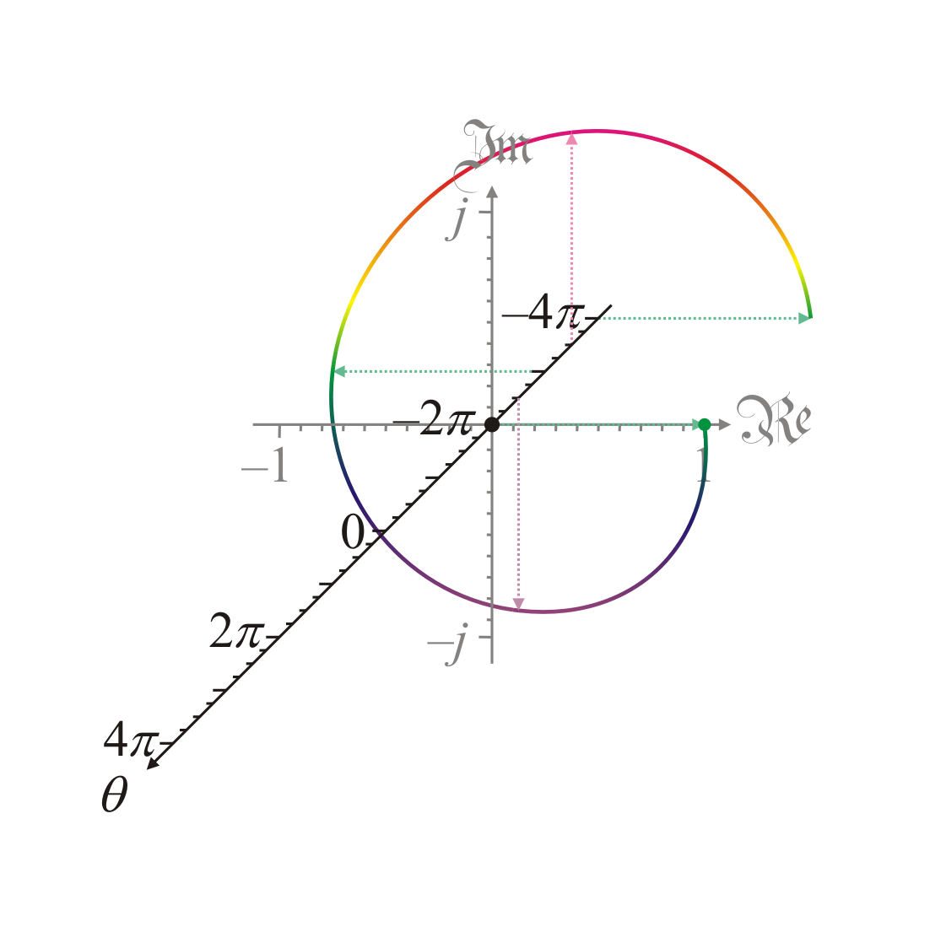
Geometric interpretation
Next, e^{–2πj} = 1
Repeating this, we note
e^{–1.5πj} = j
e^{–πj} = –1
e^{–0.5πj} = –j
e^{–0πj} = 1

Slide 23
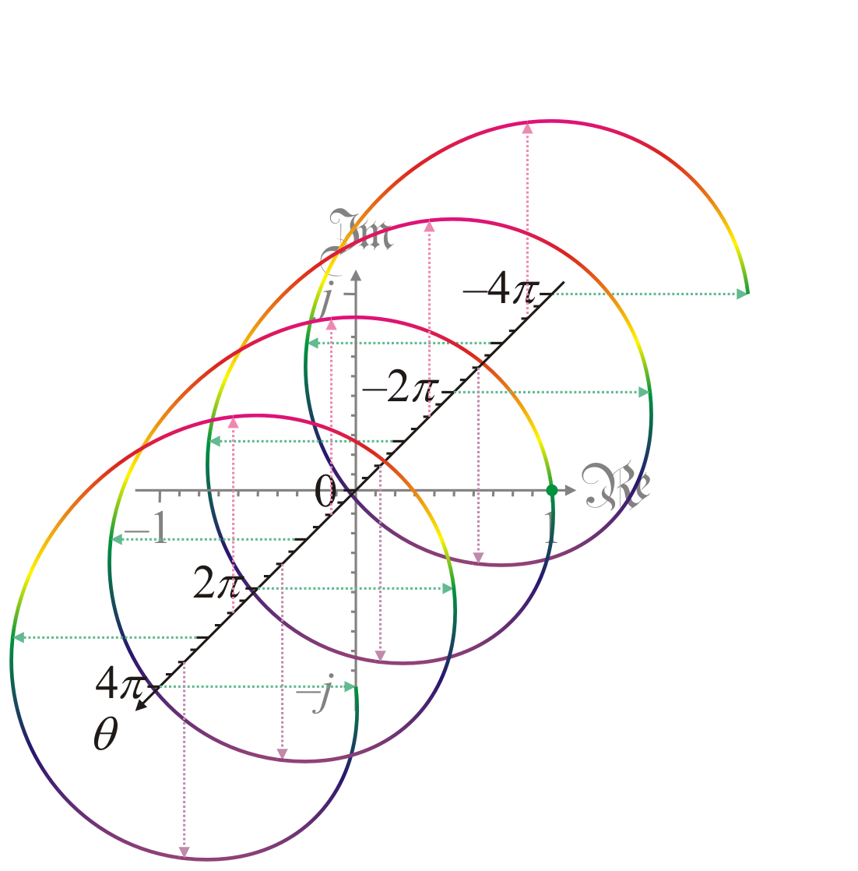
Geometric interpretation
Plotting e^{θ j} for more values of q reveals a corkscrew motion
Recall that
Here, we see that corkscrews through the complex plane for all θ

Slide 24
Complex exponential
Question?
If z = α + βj, what is e^{z} ?
Solution:
From secondary school, you know that
Thus,

Slide 25
Complex exponential
As an example, let us try this out:
For z = 0.09 – 0.3j, calculate and approximate e^{z} using the formula and the Taylor series:

Slide 26
Complex exponential
As an example, let us try this out:
Using the 5th-order Taylor series approximation, we get that

Slide 27
Complex exponential
Let us compare our two results:
Formula:
Taylor series approximation

Slide 28
Observation
Theorem:
Proof: If , then
QED

Slide 29
Observation
Theorem:
Proof: A consequence of the previous theorem.

Slide 30
Euler’s identity
Theorem:
Proof:
QED

Slide 31
Trigonometric functions
What are cos(z) and sin(z)?
We know for a real θ,
Posit that continues to be true if z is a complex number
Thus,
Thus,
Similarly,

Slide 32
Summary
In this topic, we described how to calculate the exponential function when the argument is complex
We deduce Euler’s formula
We saw that
We determined formula for e^{z}
We saw how to plot a complex-valued function of a real variable
produces a spiral in the complex plane
We checked the formulas are likely correct
Made some observations, including Euler’s identity

Slide 33
References
[1] https://en.wikipedia.org/wiki/Euler%27s_formula
[2] https://en.wikipedia.org/wiki/Euler%27s_identity

Slide 34
Acknowledgments
Discussions with and courses from Prof. John A.R. Holbrook.

Slide 35
Colophon
These slides were prepared using the Cambria typeface. Mathematical equations use Times New Roman, and source code is presented using Consolas.
The photographs of flowers and a monarch butter appearing on the title slide and accenting the top of each other slide were taken at the Royal Botanical Gardens in October of 2017 by Douglas Wilhelm Harder. Please see
https://www.rbg.ca/
for more information.

Slide 36
Disclaimer
These slides are provided for the ne 112 Linear algebra for nanotechnology engineering course taught at the University of Waterloo. The material in it reflects the authors’ best judgment in light of the information available to them at the time of preparation. Any reliance on these course slides by any party for any other purpose are the responsibility of such parties. The authors accept no responsibility for damages, if any, suffered by any party as a result of decisions made or actions based on these course slides for any other purpose than that for which it was intended.

